Slide 1
Presents
OO Programming with Java
Interfaces
Notes:
Interfaces
Module 11

Slide 2
Learning Objectives
In this chapter we will:
  Compare interfaces to abstract classes
  Learn to define and implement an interface
  Discuss the design implications of interfaces
  Discuss interface inheritance

Slide 3
Interfaces and Abstract Classes
An interface is very similar to an abstract class.
The important differences are:
  An interface can only have final attributes.
  An interface can only have abstract methods.
    Java 8 adds default and static methods.
  The syntax for creating an interface is different than an abstract class.
  Though classes can only inherit from one other class they may implement as many interfaces as needed.
  Interfaces can inherit from other interfaces, not classes.
  Interfaces can inherit from more than one other interface.

Slide 4
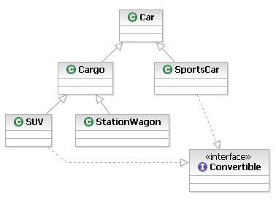
Interface Example
In this example both SUV and SportsCar need to have the attributes and methods of a Convertible. But if we create a class called Convertible we run into problems with our class hierarchy
Notes:
We stressed that interfaces provide us with a way to attach methods that are shared among objects that have different super classes.

Slide 5
Defining an Interface
Declare an interface using the interface keyword.
Declare methods by listing (in order) the access, return type, name, parameter list and a semi-colon. The semi-colon replaces the method’s code block.
Java 8
  To declare a default method, use the keyword default
    If a class implements an interface with a default method, it can opt to implement the method, otherwise the compiler will “copy & paste” the method into the class.
    A default method implementation can only be written in terms of other methods or static members, not instance data.
  To declare a static method, use the keyword static
    A static method is similarly limited to other static members.

Slide 6

Interface Example
The Convertible interface
Interfaces are defined in .java files
We might want an attribute to hold the state of the convertible top – but interfaces don’t allow that. In an interface, attributes must be final.
Notes:
Essentially, what the Convertible interface gives us is a list of methods for which any car that is a Convertible must provide code blocks for. We call this “implementing” the interface.
Assuming that the only methods we need are putTopUp() and putTopDown(), our interface would resemble the following:

Slide 7
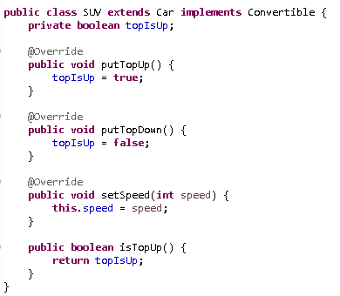
Implementing an Interface
You will need to import the interface.
In order for us to create an SUV object, we must implement all methods from the interface as well as all abstract methods from Car.

Slide 8
Implementing an Interface
To implement an interface, a class must provide an implementation for each method in the interface it implements. These become known as concrete methods.
Failure to provide method definitions in the implementing class will result in a compilation error.
  Since Java 8, default and static methods are the exceptions to this rule.

Slide 9
Using an Interface
If a given class implements a specific interface, it may be assigned to references of that interface type.
  Convertible ragTopSUV = new SUV();
The only methods you can call on ragTopSUV are putTopUp() and putTopDown(). Calling any of SUV’s methods will result in a compilation error.
ragTopSUV.setSpeed(50); // ERROR
  This is because the reference defines the interface.

Slide 10
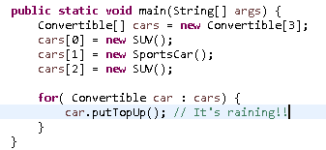
Design Implications
Classes that are otherwise unrelated can be manipulated using an interface they both implement.

Slide 11
Example
The abstract class Car has bean properties for name and speed.
In another portion of code, we have a similar class that we would also like to treat in polymorphic manner to the way we work with cars.
In consultation with stakeholders, we define a new interface, Vehicle, that expresses the common contract that we want.
  Vehicle will have two bean properties
    name
    speed

Slide 12
Example: The Vehicle Interface
package com.learnquest.demos.transport;
public interface Vehicle {
public String getName();
public void setName(String name);
public int getSpeed();
public void setSpeed(int newSpeed);
}

Slide 13
Example
We want to incorporate a third party class, Train, which has three bean properties:
  name
  RPM
  wheelSize
We will pretend that we don’t even have access to the Train class source code to modify it, and so we will create our own Train subclass that extends Train and implements Vehicle.
We will amend CarApp to use Trains as well.

Slide 14
Example: The Original Train Class
package com.devtech.training.transportation;
public class Train {
public Train(String name) {
setName(name);
setWheelSize(60);// Assume 5' diameter of the wheel
}
public String getName() { return name; }
public void setName(String name) { this.name = name; }
public int getRPM() { return rpms; }
public void setRPM(int rpms) { this.rpms = rpms; }
public int getWheelSize() { return wheel_size; }
private void setWheelSize(int sz) { wheel_size = sz; }
// … attributes omitted
}

Slide 15
Example: The Train Subclass
package com.learnquest.demos.transport;
public class Train
extends com.devtech.training.transportation.Train
implements Vehicle {
public Train(String name) { super(name); }
// The name property can be inherited; implement speed
public int getSpeed() {
return (int) (2 * Math.PI * (getWheelSize() / 2)
/ 12 * getRPM() * 60 / 5280);
}
public void setSpeed(int speed) {
setRPM((int)(mph * 5280 * 12 /
(2 * Math.PI * (getWheelSize() / 2) * 60)));
}
// … attributes and toString() omitted
}

Slide 16
Example: Calling the setSpeed method
// … existing code omitted …
Train train = new Train("City of New Orleans");
for (Vehicle vehicle:
new Vehicle[]{ car54, mach5, wagon,
suv, train }) {
travelAtSpeedLimit(vehicle);
System.out.println(vehicle);
}

Slide 17
Example Concluded
Through the use of an interface, which ensures that a signature exists for the method, we have successfully introduced polymorphism across our otherwise disjoint hierarchy.
When vehicle is referring to a SportsCar, Java calls the setSpeed()method for SportsCar. When the vehicle is an SUV, Java calls the Cargo setSpeed() method (inherited by SUV). And when the vehicle is a Train, Java calls that class’ setSpeed() method.
The reference type defines what you can do with an object, but the actual class defines the implementation.

Slide 18

Extending Interfaces
An interface may also participate in an inheritance relationship using the extends keyword:
Notes:
Here we have a convertible roof that contains a dome light.

Slide 19
Extending Interfaces
We’ll create a new class called LuxurySportsCar, which implements SoftTopWithLight.
Since SoftTopWithLight extends Convertible, LuxurySportsCar must implement the methods of both interfaces.
The code appears on the next slide.

Slide 20
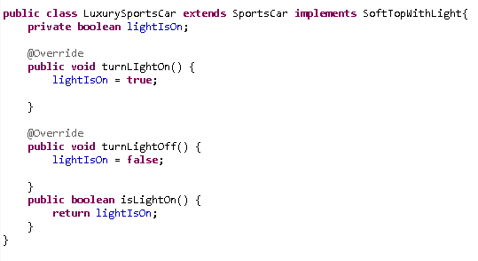
Extended Interface Example
Notes:
Since LuxurySportsCar extends SportsCar, it inherits the implementations for the methods in the Convertible interface.

Slide 21


Extending Interfaces
Unlike a class, an interface can inherit from more than one other interface:

Slide 22
Implementing an Extended Interface
To implement DeluxeSoftTop, a class must provide code blocks for all of the methods in:
  RearWindowDefogger
  SoftTopWithLight
  Convertible
  As well as any methods defined in DeluxeSoftTop itself
On the next slide we modify the code for LuxurySportsCar to implement DeluxeSoftTop.

Slide 23
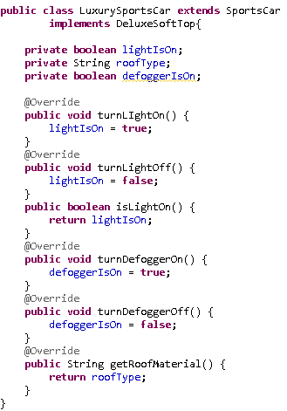
Implementing Interfaces
All methods in all interfaces must be implemented.
This will typically require new attributes to be added to manage the data associated with the methods in the interfaces.
Notes:
It is also possible to implement multiple interfaces using a single concrete class. The only stipulation is that all methods must be implemented.

Slide 24
Design Issues with Interfaces
Between classes, abstract classes, and interfaces, we have many options for designing our Java solutions.
Which options are best? That depends on the details of the particular system. Good design comes with practice and a thorough knowledge of each option.
In the next slide we list some general best practices.

Slide 25
Design Practices
Interfaces
  The strength of interfaces is that they can be applied across the inheritance hierarchy, and support multiple inheritance. They are crucial to implementing widespread polymorphism in Java.
  The weakness of interfaces is that they cannot provide implemented methods that interact with attributes, because interfaces cannot declare attributes.
    As of Java 8, default methods can be coded against other methods that you declare in the interface, including setters and getters, leaving the implementing classes to implement those.
Abstract Classes
  The strength of abstract classes is that they can provide attributes and some methods with code blocks.
  The weakness of abstract classes is that, as with any class, they can only inherit from one superclass.

Slide 26
Design Practices
Use interfaces where a consistent set of methods is required across the class hierarchy.
  Interfaces provide polymorphism without regard for either method implementation or the class inheritance hierarchy.
To make the most of abstract classes, use them where they can effectively provide method implementations to be reused by their subclasses. Abstract classes should be viewed as a means to share implementation with subclasses.
Client code should be written, whenever possible, to interfaces, not specific classes. And generally never should client code know of, or refer to, abstract classes.

Slide 27
Design Practices
Basically, whenever you design a business logic interface…
  Make it an interface, literally. Then create one or more implementations of that interface, as desired.
  If you have multiple implementations of the interface that could properly, and conveniently, share at least parts of the implementation, consider refactoring those parts into a common abstract class.
As long as client code relies only upon the published interface, you are free to refactor as necessary without breaking client code.

Slide 28
Challenges in Interface Evolution
If you add a new method to a parent class, as long as it is not abstract, child classes inherit the new method, and therefore they are not broken.
However, if you add a new method to an interface, every class that implements that interface must provide an implementation, or the code is now broken. The class lacks an implementation of a method that a client may expect.
In Java 8, this problem reached a breaking point, and Sun introduced a solution ...

Slide 29
Java 8: default and static methods
In Java 8, when declaring a method on an interface, a default implementation can be provided.
  The default implementation can only be written in terms of other methods or static members, not instance data.
  The default implementation will be provided to any class that does not otherwise provide its own implementation.
  public default void reverse(int distance) {
  forward(-distance);
  }
Java 8 also introduced the ability to declare static methods on an interface.

Slide 30
Functional Interfaces
What is a Functional Interface?
  an interface that has only one abstract method declared in it
An example of a functional interface is java.lang.Runnable
  There is only one method called run()
Another example of a functional interface is java.lang.AutoCloseable
  There is only one method called close()
  This interface was added in Java 7 to support the try-with-resources statement, which requires a polymorphic way to close instances of arbitrary resource types.
  Many resources already had a close method, but lacking a common interface, they were not polymorphic. Simply adding implements AutoCloseable to them resolved the problem. See how crucial interfaces are to polymorphism?

Slide 31
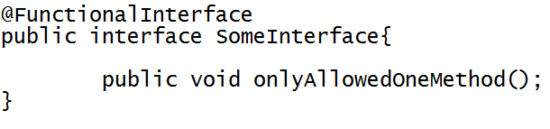
Functional Interface
In Java 8, you can use a new annotation to indicate that an interface type declaration is intended to be a functional interface.
Analogous to @Override, this explicit annotation can be used to provide a compiler error when the interface you have annotated is not a valid functional Interface, but is not required to simply be a functional interface.
Notes:
A functional interface is a new interface added in Java 8 to indicate that an interface type declaration is intended to be a functional interface. @FunctionalInterface can be used for compiler level errors when the interface you have annotated is not a valid functional Interface.

Slide 32
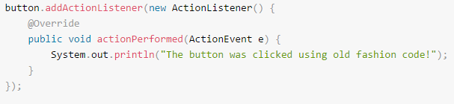
Functional Interfaces
Prior to Java 8, we used Adapter or Anonymous classes to instantiate objects of functional interfaces.
Notes:
Lambda expressions can simplify this process….

Slide 33
Lambda Expressions
What is a lambda expression?
  A lambda expression is used as an anonymous function
  A shorthand notation that allows you to write a method in the same place you are going to use it
  Makes it easy to pass a block of code as a parameter to code that is expecting an implementation of the functional interface.
When should lambda expressions be used?
  Where you want an easy way to express an implementation of a functional interface with the code using it.
  Useful where a method is being used only once, and locally.
Notes:
A difference between using Anonymous class and Lambda expression is the use of this keyword. For anonymous class ‘this’ keyword resolves to anonymous class, whereas for lambda expression ‘this’ keyword resolves to enclosing class where lambda is written. The Java compiler compiles lambda expressions and convert them into private method of the class.

Slide 34


Lambda Expression
Syntax
  an argument list enclosed in parentheses, an arrow token (->), and a function body.
    As a special case, if there is exactly one parameter, the parentheses can be omitted.
  The body can be either a statement block (enclosed in braces) or a single expression.
    If a single expression, the compiler will insert return as necessary.
  Each lambda expression can be implicitly assigned to a functional interface
    This type of conversion is automatically done by the compiler
Notes:
A lambda expression can have zero, one or more parameters.
The type of the parameters can be explicitly declared or implicit e.g. (int a) is same as just (a)
Parameters are enclosed in parentheses and separated by commas. e.g. (x, y) or (int x, int y) or (String x, int y, float z)
Empty parentheses are used to represent an empty set of parameters. e.g. () -> 10
When there is a single parameter, if its type is implicit, it is not mandatory to use parentheses. e.g. x -> return x*x
The body of the lambda expressions can contain zero, one or more statements.
If body of lambda expression has single statement curly brackets are not mandatory and the return type of the anonymous function is the same as that of the body expression.
When there is more than one statement in body than these must be enclosed in curly brackets (a code block) and the return type of the anonymous function is the same as the type of the value returned within the code block, or void if nothing is returned.

Slide 35
Summary
The keyword implements is used to implement an interface.
  A functional interface is an interface that has only one abstract method declared in it
Inheritance facilitates common processing for otherwise unrelated classes using polymorphism.
Interfaces can participate in single or multiple inheritance relationships.

